Slide 1

ROCKBUSTER
DATA ANALYSIS
& Strategic Planning

Slide 2

Project Overview
Rockbuster Stealth LLC is a movie rental company that used to have stores around the world. Facing stiff competition from streaming services such as Netflix and Amazon Prime, the Rockbuster Stealth management team is planning to use its existing movie licenses to launch an online video rental service in order to stay competitive.

Slide 3
Key Questions
Which movies contributed the most/least to revenue gain?
What was the average rental duration for all videos?
Which countries are Rockbuster customers based in?
Where are customers with a high lifetime value based?
Do sales figures vary between geographic regions?

Slide 4

Rockbuster Overview
Number of Staff
2
Average Rental Rate Per Category | ( In days)
rating | avg
PG | 3.05185567
R | 2.938717949
NC-17 | 2.970952381
PG-13 | 3.034843049
G | 2.888876404
Total Revenue
$61,312.04
Total Inventory
16,044
Average Rental Cost
$2.98
Total Customers
599
Average Rental Duration
5 days

Slide 5

Which movies contributed the most/least to revenue gain?
Most Popular Genres | Revenue Generated
Sports | $4892.19
Sci-Fi | $4336.01
Animation | $4245.31
Sports movies have been the most profitable worldwide, bringing in $4,892.19 of revenue
Least Popular Genres | Revenue Generated
Thriller | $47.89
Music | $3071.52
Travel | $3227.36
The Thriller genre has been suffering and is trailing by far, bringing in only $47.89 of revenue in 2020.

Slide 6
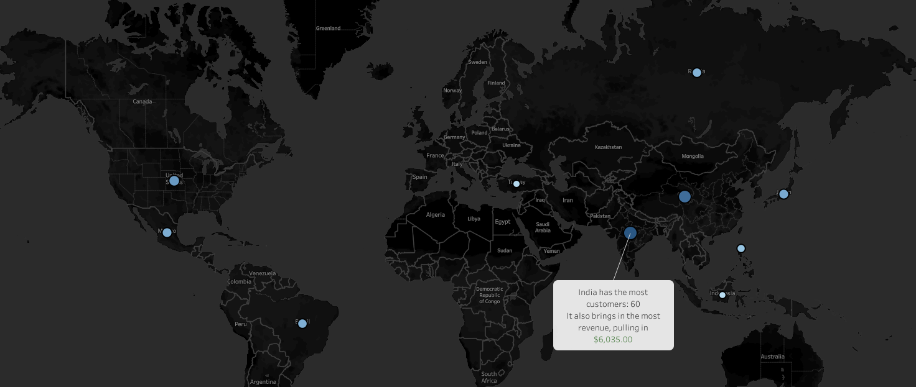
Top 10 Countries
Country | Customers
India | 60
China | 53
United States | 36
Japan | 31
Mexico | 30
Brazil | 28
Russian Federation | 28
Philippines | 20
Turkey | 15
Indonesia | 14

Slide 7
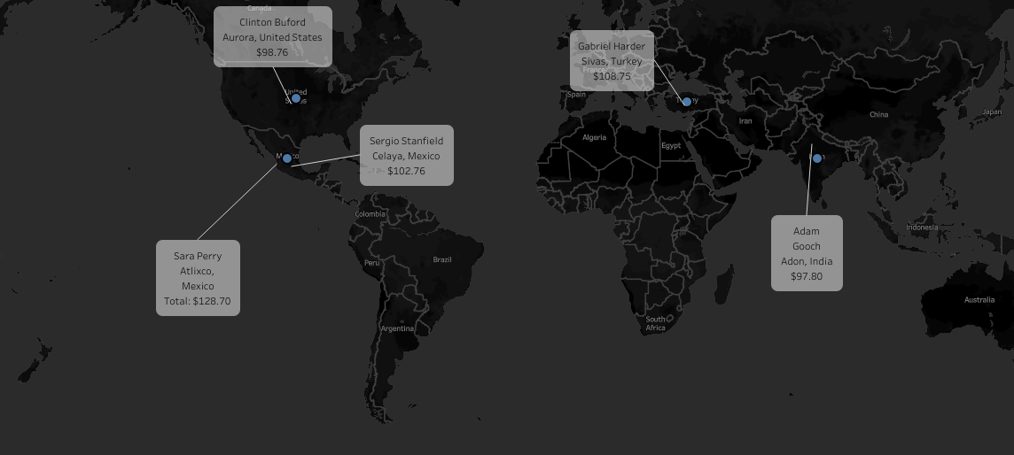
Where are customers with a high lifetime value based?
First name | Last name | City | Country | Total amount paid
Sara | Perry | Atlixco | Mexico | $128.70
Gabriel | Harder | Sivas | Turkey | $108.75
Sergio | Stanfield | Celaya | Mexico | $102.76
Clinton | Buford | Aurora | United States | $98.76
Adam | Gooch | Adoni | India | $97.80

Slide 8
Recommendations
Rockbuster should focus on the countries with the most clients as they also generate the most revenue.
Management needs to find out why the disparity between Thriller movies and other genres is so large.
To effectively compete with large streaming platforms such as Netflix or Amazon, Rockbuster must make its film selections available online to customer for a monthly subscription fee.

Slide 9
Links
https://public.tableau.com/app/profile/kevin.sousa/viz/ROCKBUSTERTOPcountries/Mapofcustomers
https://public.tableau.com/app/profile/kevin.sousa/viz/ROCKBUSTERTOPCLIENTS/Mapofcustomers

